Slide 1
Neural Network Model for the Sales of a Butcher Shop
Tucker Lebor

Slide 2
Olde Towne Butcher
A butcher shop in Fredericksburg, VA.
Sells various high-end organic goods and produce.
Also includes a small restaurant.
Highly anomalous sales, especially around holidays.

Slide 3
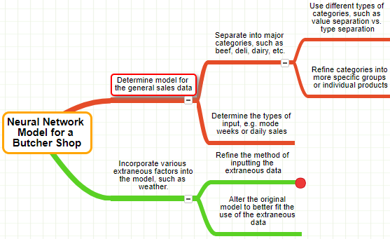
Plan

Slide 4
Comparison to previous research
The resulting model will be a combination of a time-series prediction and a correlation/recommendation system.
Studies have been done on both sales prediction (Penpece & Elma, 2014), and product correlation (Sano, Machino, Yada, & Suzuki, 2015).
However, few have done both simultaneously.

Slide 5
Methods
Matlab with the neural network toolbox will be used to create the network
The data will be input into a NARX neural network as an array of time series
Data will be filtered through Excel to convert it to the preferred format/type

Slide 6
Bibliography
Penpece, D., Elma, O. E. (2014). Predicting sales revenue by
using artificial neural network in grocery retailing industry:
a case study in Turkey. International Journal of Trade,
Economics and Finance, 5, 435-439. Sano, N., Machino, N., Yada, K., & Suzuki, T. (2015).
Recommendation system for grocery store considering
data sparsity. Procedia Computer Science, 60,
1406-1413.

